Slide 1
CS2040 Lab08 B03 (Please set up your camera for Visualgo quiz) 19/10/2020

Slide 2
Diameter
Lab07 Q1

Slide 3
Problem statement
Find the diameter of a tree
The diameter of a tree (sometimes called the width) is the number of nodes on the longest path between two end nodes.
Input:
The first line contains a single integer n (1≤n≤1000) – the number of nodes of the tree
The second line contains n-1 integers pi (1≤pi≤n) - pi is the parent node of the (i+1)th node. The tree’s root is node 1.
It’s guaranteed that the given tree will be a binary tree.
Output: A single integer is the diameter of the tree

Slide 4
Basic idea
Use a recursive function traverse to recursively compute the diameter and height(maxDepth) of each node (regard each node as the root of a subtree).
If a node has both left and right child, its diameter can be generated from the following three cases:
The diameter of its left child (diameter in left subtree)
The diameter of its right child (diameter in right subtree)
Go from the deepest node in its left child to the deepest node in its right child (diameter passes through root)
The diameter of this node is the maximum among the diameter of its left child, the diameter of its right child, and (thisNode.left.height + thisNode.right.height + 2)

Slide 5
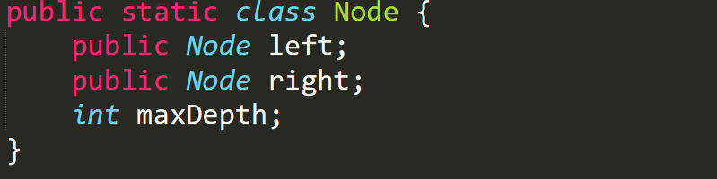
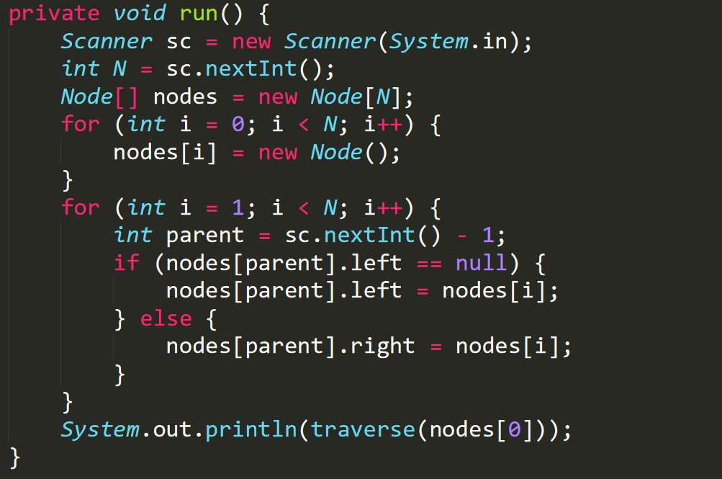
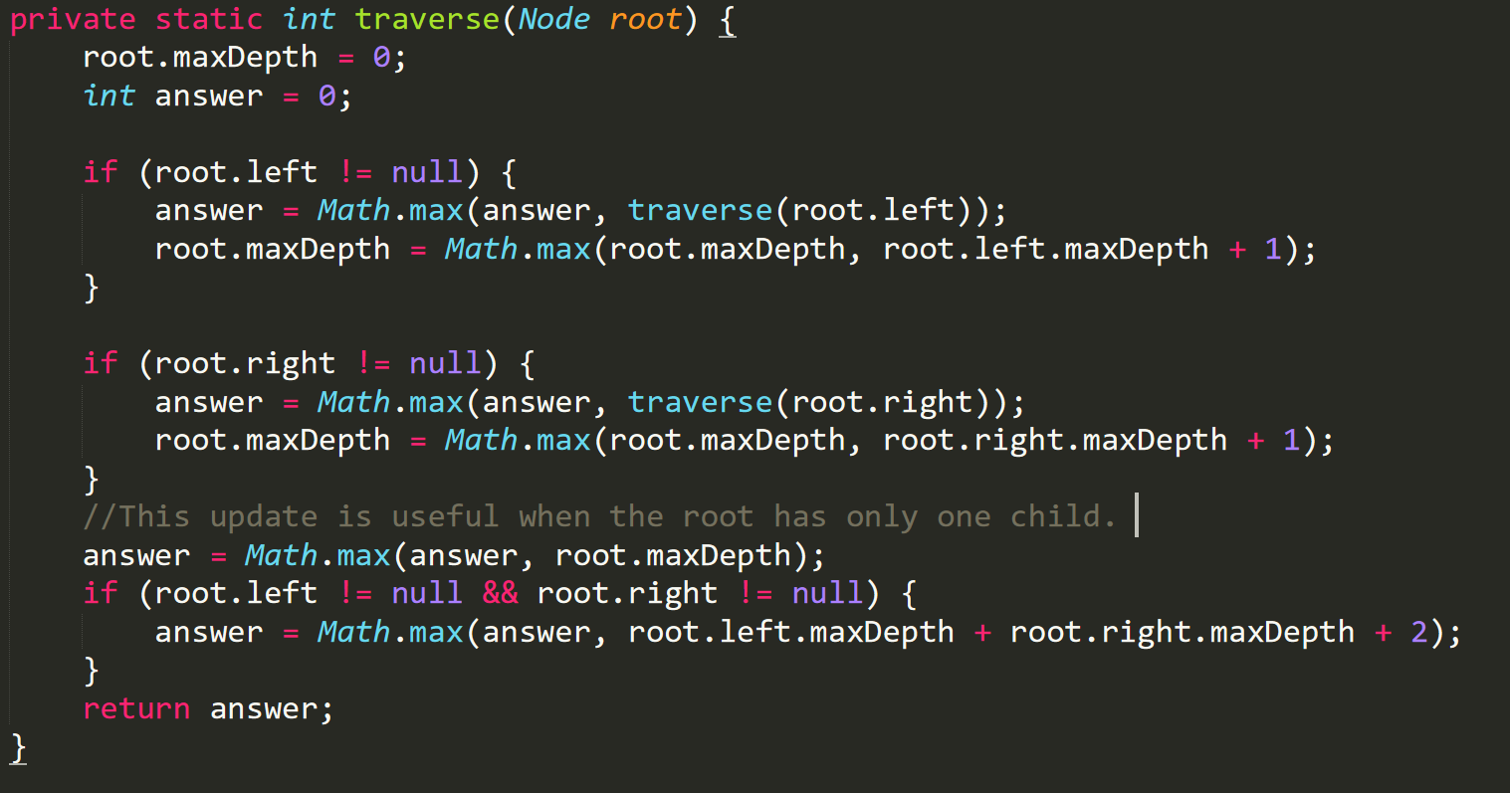
Solution

Slide 6
DICTIONARY
Lab 07 Q2

Slide 7
PROBLEM STATEMENT
Given:
n list of words, each word consist of only ‘a’ and ‘b’ (this is your dictionary)
process q queries
Each query is a word s, and we want to check how many words from the dictionary has prefix s

Slide 8
INPUT / OUTPUT
Input:
First line contains two integers: n (number of words) and q (number of queries)
Next n lines will each contain a word in the dictionary
Next q lines will each contain a word
Output: Integers for each query, representing how many matching prefixes there are with the dictionary

Slide 9
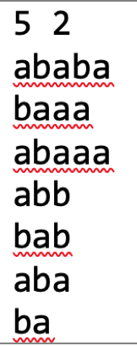
EXAMPLE FROM TEST CASE
R
HOW to put them in tree?
A
B
B
A
HOW to count matching prefixes for each query?
A
B
A
B
A
B
A
A
A

Slide 10
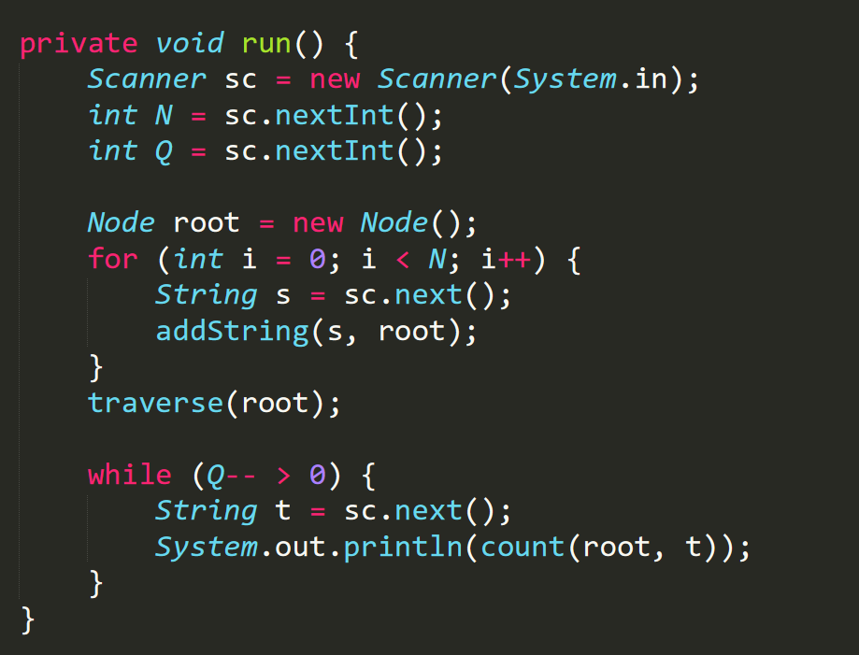
Solution

Slide 11
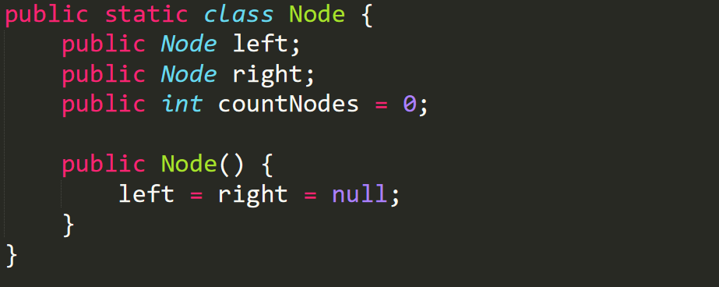
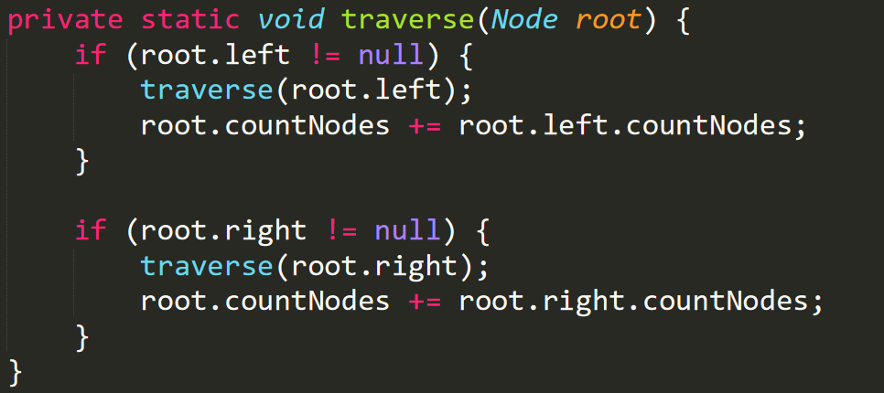
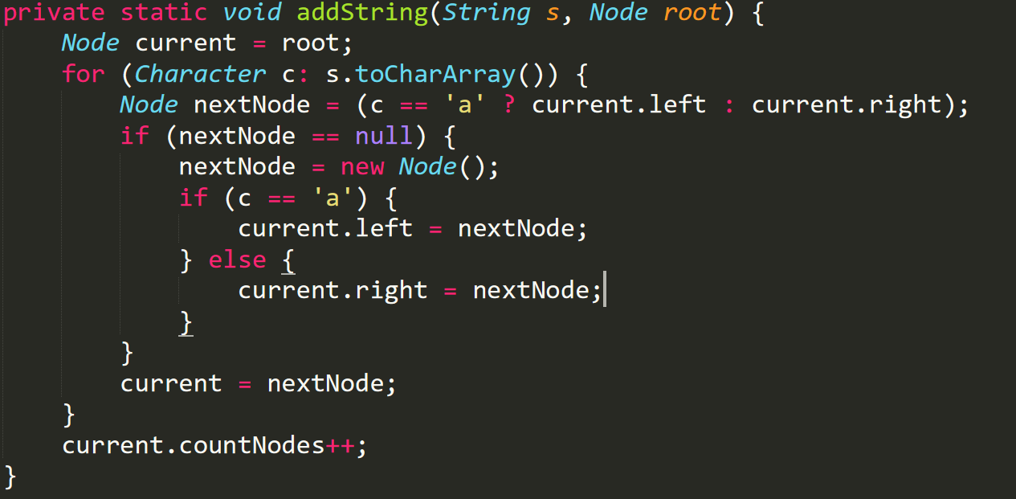
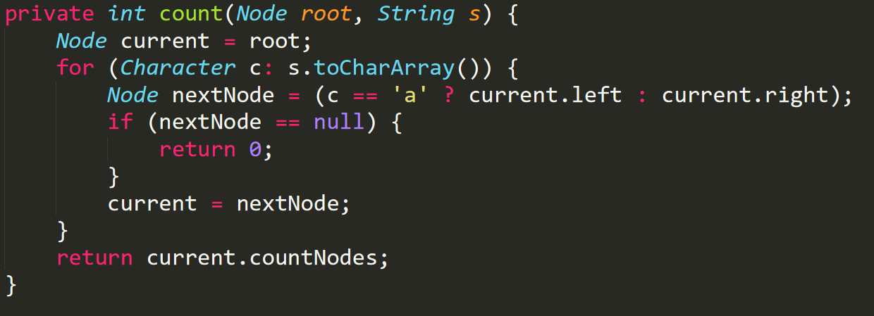
Solution

Slide 12
Visualgo quiz

Slide 13
Visualgo quiz
10 questions in 10 minutes
The meeting will be recorded during quiz.
Make sure you record the whole screen including the timestamp
Upload your recording to TG group immediately after the quiz (don’t edit your message if you upload a wrong video, just send another message to upload),
and name your video as NAME+MATRIC NUMBER+ SCORE
https://visualgo.net/training?diff=hard&n=10&tl=10&module=bst+avl

Slide 14
Add
Lab8 Q1

Slide 15
Problem Statement:
Query 1: Insert the number into the heap
Query 2: Increase all elements in the heap by integer
Query 3: Pop the element with the smallest value out of the heap and print its value

Slide 16
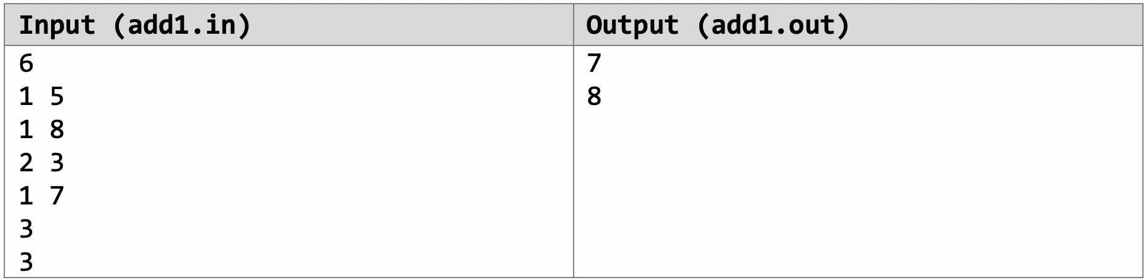
Example 1:
We have the state of the heap after each query as follows:
After the 1st query: 5
After the 2nd query: 5,8
After the 3rd query: 8,11
After the 4th query: 7,8,11
After the 5th query: 8,11 (7 is the smallest element hence got popped out) print
After the 6th query: 11 (8 is the smallest element hence got popped out) print

Slide 17
Basic Idea and Data Structure
Find a Data Structure that allows you to those the following 3 queries:
Inserting of variables
Removal of smallest elements
Increasing all elements in the heap by x

Slide 18
Things to note:
How do you add the value of x to all the elements that entered different times
How do you get the smallest value out?

Slide 19
Median
Lab 8 Q2

Slide 20
Problem 2: Median
Problem Breakdown:
Input:
1 Integer : Number of operations (N)
N sequences of 2 possible inputs:
Insertion of number into heap
Output the median if size of heap is odd else print the 2 median of the heaps in ascending order
Output:
Show the correct output when the input is “2”.

Slide 21
Problem 2: Median
Discussion:
Data Structure:
As mentioned in the question, we will be modelling this problem with 2 heaps.
Idea:
Manipulating the 2 heap such that after each insertion of element, you can easily get the median in O(1) time.
One of the heap has to be a max heap, Java’s priority queue is a minheap by default
Can do so through numerous ways (i.e Comparator.reverseOrder(), you make a new comparator, lambda expressions etc.)
To manipulate correctly you need to maintain the size of the 2 heaps to make sure that their size do not differ by more than 1, making sure it is consistent, i.e heap1 is always having a larger size than heap2.

Slide 22
Problem 2: Median
Example: N = 7
1 5 → Insert into heap A
1 8 → Insert into heap B
2 → print (5 8)
1 20 → Insert into heap B
2 → print (8)
1 17 → Move 8 into heap A and Insert into heap B
2 → print (8 17)
Heap A = [ 5 ]
Heap A = [ 5 ]
Heap A = [ 5 ]
Heap A = [ 5, 8 ]
Heap A = [ 5, 8 ]
Heap A = [ 5 , 8 ]
Heap A = [ 5 , 8 ]
Heap B = [ ]
Heap B = [ 8 ]
Heap B = [ 8 ]
Heap B = [20 ]
Heap B = [ 20 ]
Heap B = [ 17 , 20 ]
Heap B = [ 17 , 20 ]

Slide 23
BOARD
Lab 8 Q3

Slide 24
PROBLEM STATEMENT
Given an N x N chessboard, with each cell from row 1 to N and col 1 to N represented by a unique value it contains, we need to solve the following possible queries:
R x = print and remove the largest element from row x
C y = print and remove the largest element from column y
If corresponding row / column is empty, print “None”
Queries use 1-based indexing

Slide 25
INPUT
First line contains an integer N indicating size of the board (the board is N x N)
Subsequent N lines each contains N numbers. This is a 2D array representing the board
Following line contains an integer Q representing number of queries
Subsequent Q lines each contains a query of the form (R x) or (C y)

Slide 26
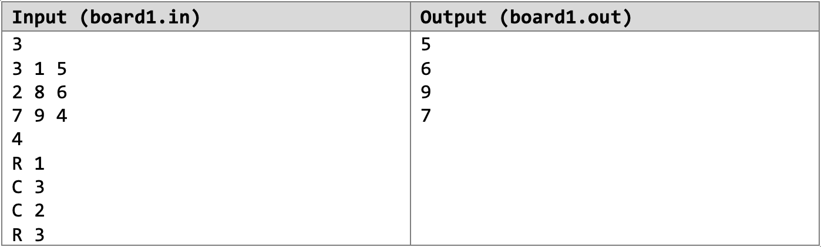
SAMPLE TEST CASE

Slide 27
DATA STRUCTURES
Define Cell class representing {row, column, value}
PriorityQueues of Cells for Rows and Columns (Two Arrays of PQs)
Java PQ is a MinHeap implementation.
Cell should implement Comparable<Cell>
Or, we can initialize PQ with Cell Comparator
We need PQ to behave as a MaxHeap
2D boolean[][] “deleted” array: keep track of deleted values
Remember that queries use 1-based indexing

Slide 28
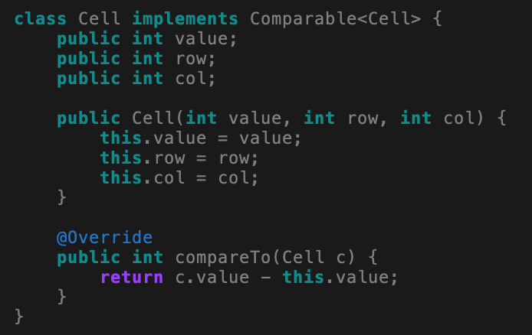
IMPLEMENT COMPARABLE

Slide 29
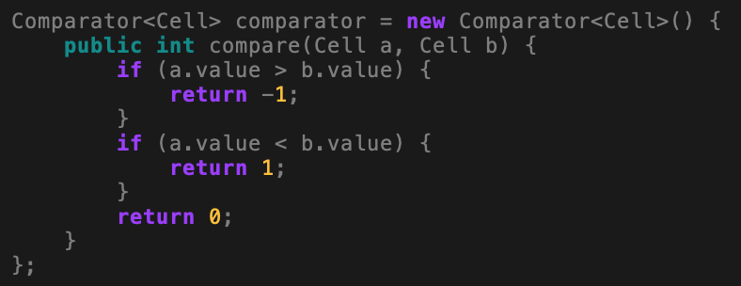
CELL COMPARATOR
Option 1:
Option 2: using Lambda expression
Comparator<Cell> comparator = (Cell x, Cell y) 🡪 y.value – x.value;

Slide 30
INITIALIZING PQ
new PriorityQueue<Cell>(); // Cell needs to implement Comparable
new PriorityQueue<Cell>(comparator); // we pass Comparator into PQ

Slide 31
PSEUDOCODE
Initialize Two arrays of PQs
rows array, where rows[i] = PQ containing cells in row i
columns array, where columns[k] = PQ containing cells in column k
For each Cell at row x and column y,
We store the Cell in rows[x] and columns[y], both of which are PQs

Slide 32
PSEUDOCODE
For each query:
Take relevant PQ (e.g. C x means the PQ is columns[x]) // 1-based indexing ?
found = false
while relevant PQ is not empty
Cell curr = poll from PQ
if deleted[curr.row][curr.col] is true, continue
set deleted[curr.row][curr.col] = true, set found = true
If found, print curr’s value, else print None

